Slide 1
TechFar Hub v3
Project initiation
U.S. Digital Service // Presenter name // month year

Slide 2




Executive summary
Problem
Solution
Context
Mission Impact
The current TechFar Hub site was a valuable resource for digital IT acquisition when it was first launched many years ago, but since then it has gone stale. Several attempts have been made to revive it, none led to a successful, living site.
If we are able to revamp content and navigation based on research and understanding of the digital IT acquisition professional community, then TechFar Hub can become relevant again as the leading source of critical thinking and community.
There are many digital resources out there focused on acquisition innovation, but only TechFar Hub concentrates on digital IT acquisition. It is therefore still a resource with a strong demand from a very specific audience.
The way the government spends money permeates everything that we do. The ability to reduce risk and spend smarter is essential knowledge for government procurement professionals. TechFar Hub can again be the thought leader in this space.

Slide 3
Vision
For government acquisition professionals, TechFar Hub is the leading voice in digital services procurement best practices.
Unlike other sites, TechFar Hub is completely focused on digital services acquisition, offering critical thinking, promoting resources and connecting the community.

Slide 4
Why TechFAR?
There are many acquisition innovation resources, however:
Context: We want to provide context and add a layer of critical thinking.
Promotion: We want to find and promote resources that add value, without duplication.
Credibility: DITAP is still a valuable program and it needs resources to provide to instructors, as well as practitioners looking to implement it in the real world.
Top Cover: We want USDS to continue to be a leading voice in digital services best practices. We can provide top cover for teams to get buy in, carrying the momentum from the Digital Services Playbook and earlier versions of the TechFAR.

Slide 5
OBJECTIVES & KEY RESULTS
Objective: Update site content to be fresh, relevant and easy to navigate.
Key result 1: Devise a research-backed information architecture which makes it easy to find things
Key result 2: Audit current content and create new content that reflects current thought leadership
Key result 3: Create a strategy for gathering & promoting resources from the wider community

Slide 6
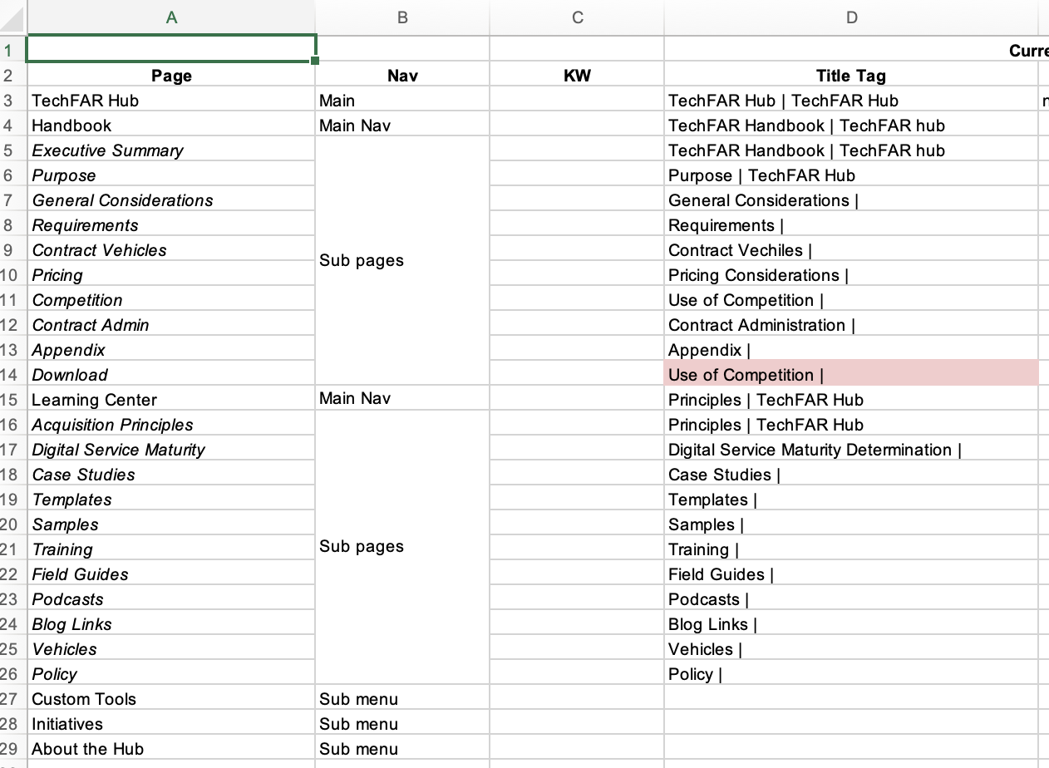
HIGH-LEVEL GOALS
Updated user research (MUST)
Information Architecture (MUST)
Content audit (MUST)
Content Strategy (MUST)
New content (MUST)
Website technology evaluation (MUST)
Technology revamp (COULD)
Information Architecture

Slide 7





Who is the primary audience?
Innovation-minded
Demographics
Government procurement professionals
Vendors (focused on Federal contracts)
Characteristics
DITAP certified professionals
Innovation-minded
New to digital services
The Vendor
The Pro
The Enthusiast
Digital service novice
Digital service skilled
The Obstructionist
The Traditionalist
Traditional mindset
Notes:
Why we did this study, what we found

Slide 8







What do our users need?
Digital Services acquisition professionals have a lot of functional and emotional needs, which are detailed in the appendix. These are their high-level functional jobs.
Reduce lead time
Increase cost savings
Reduce barriers to entry
Improve customer satisfaction
Reduce protests
Achieve better mission results
Get buy-in
Notes:
Why we did this study, what we found

Slide 9
RESEARCH PLAN
This should be a very high-level research plan.
HYPOTHESIS
METHODOLOGY
OUTPUT
What do you believe should be tested to see if it is true?
How will you go about testing your hypothesis?
What will you produce as a result of this research?

Slide 10
TIMELINE
MILESTONE
MILESTONE
MILESTONE
Date
Date
Date
MILESTONE
MILESTONE
MILESTONE
Date
Date
Date
List any major delivery milestones, external deadlines, known dates.

Slide 11
Communications plan
Consider any external comms. This could be agency announcements, press releases , etc
1
[What is the initial communication?]
2
[Will there be another?]
3
[Remember to add info on the message and the intended audience]

Slide 12
DELIVERY STRATEGY
Consider who will be doing the work of delivery and how they will go about doing it.
See the full list of Engagement Models
Engagement Model: [Title of the Engagement Model]
[Why is this the appropriate engagement model?]
[Is technical project management needed?]
[What is the agile delivery approach?]
[Who is involved in delivery? The agency? Contractors?]
[What is the capacity at the agency & at USDS?]
[What is the proposed exit strategy for USDS?]
Notes:
https://github.com/usds/usds/blob/af4fabd5226daf3c03c224568f3f4c89ed118496/engagements/engagement-models/models.md

Slide 13
DACI MATRIX
Role
Project Sponsor | [name]
OMB Examiner
Agency Lead
SADel
Project Lead
Product
Design
Engineering
Procurement
Operations
Driver
Approver
Contributor
Informed

